Slide 1
Data analyst professional practical exam submission
BY: SHAKER FAYEZ

Slide 2
Agenda
1- New product sales methods (Background info)
2- Questions walkthrough
3- Question l (How many customers for each approach)
4- Question ll.l (Overall spread of revenue)
5- Question ll.ll (Spread of revenue for each method)
6- Question lll (Difference in revenue over time)

Slide 3

New product sales methods
Six weeks ago, we launched a new line of office stationery.
Despite the world becoming increasingly digital, there’s still demand for notebooks, pens, and sticky notes. Our focus has been on selling products to enable our customers to be more creative, focused on tools for brainstorming.
We have tested three sales strategies for this, targeted email and phone calls, as well as combining the two.
Email: Customers in this group received an email when the product line was launched, and a further email three weeks later. This required very little work for the team.
Call: Customers in this group were called by a member of the sales team. On average members of the team were on the phone for around thirty minutes per customer.
Email and Call: Customers in this group were first sent the product information email, then called a week later by the sales team to talk about their needs and how this new product may support their work. The email required little work from the team, the call was around ten minutes per customer.

Slide 4

Questions of Focus for Pens and Printers We need to know
1. How many customers were there for each approach?
2. What does the spread of the revenue look like overall? And for each method?
3. Was there any difference in revenue over time for each of the methods?
4. Based on the data, which method would you recommend we continue to use? Some of these methods take more time from the team so they may not be the best for us to use if the results are similar.

Slide 5
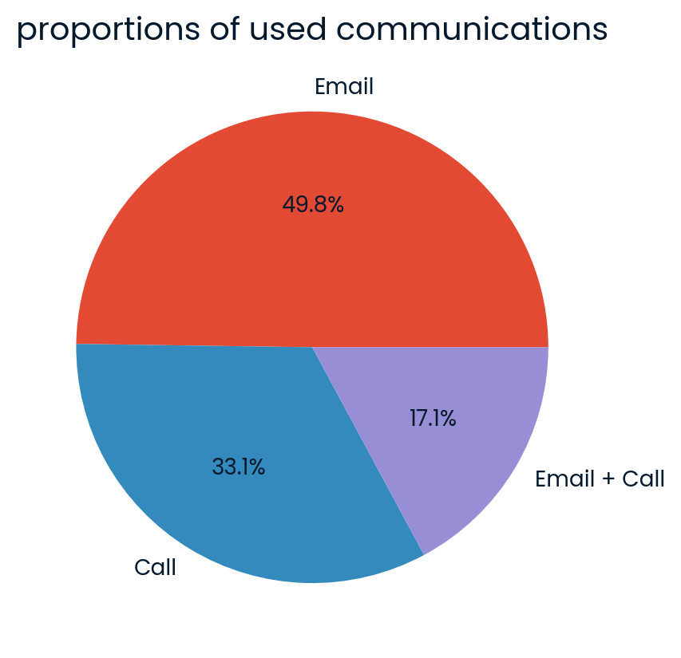
Exploratory Analysis - Question 1
How many customers were there for each approach?
● The most customers were converted through the Email sales method, coming in at 6,921 customers.
● Next, was the Call Method which accounted for just under 5000 customer sales.
● Last was the Email + Call method which was only responsible for around 2,300 sales.

Slide 6
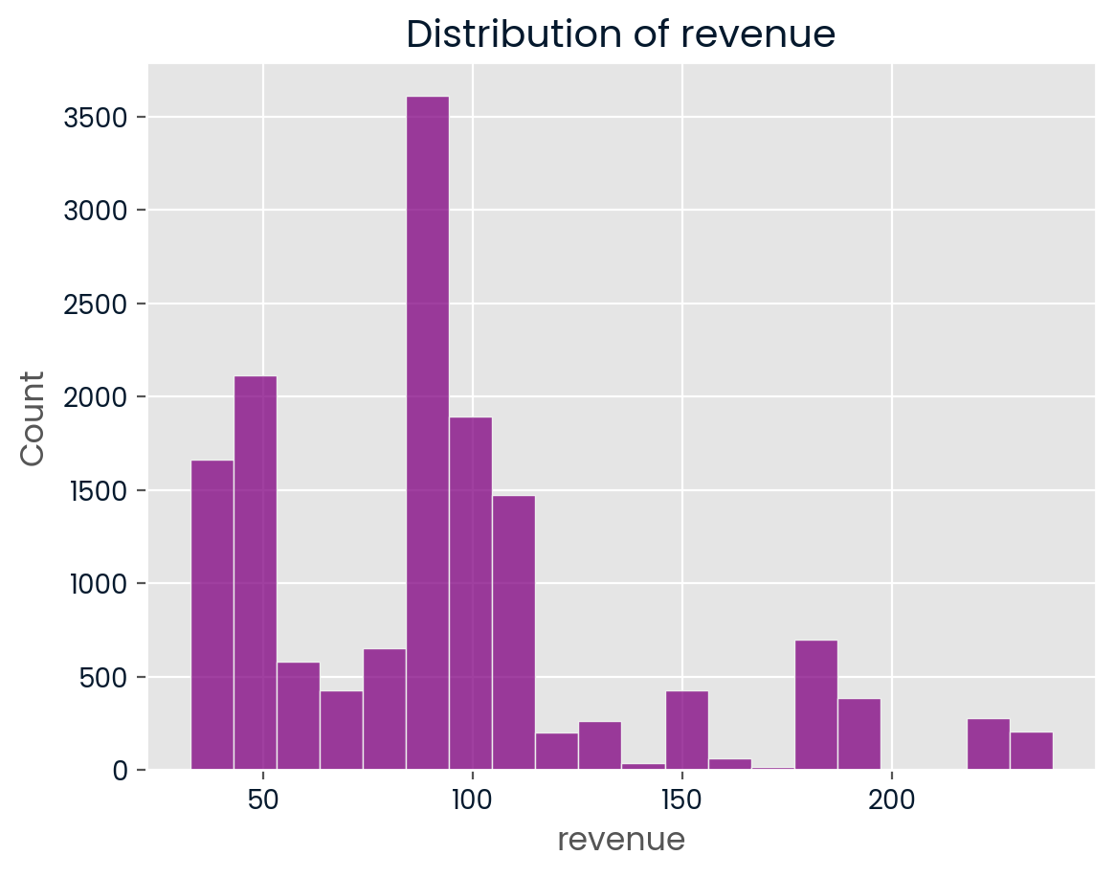
Exploratory Analysis - Question 2
What does the spread of the revenue look like overall?
● From the included histogram, we can see that most of the sales fall between $50-$90 with a visible rise in number of sales at the $50 and a peak concentration of sales in the $80-$90 range.
● The spread of the revenue on the histogram displays multi-modal distribution with high points at 50 and a peak at 80

Slide 7
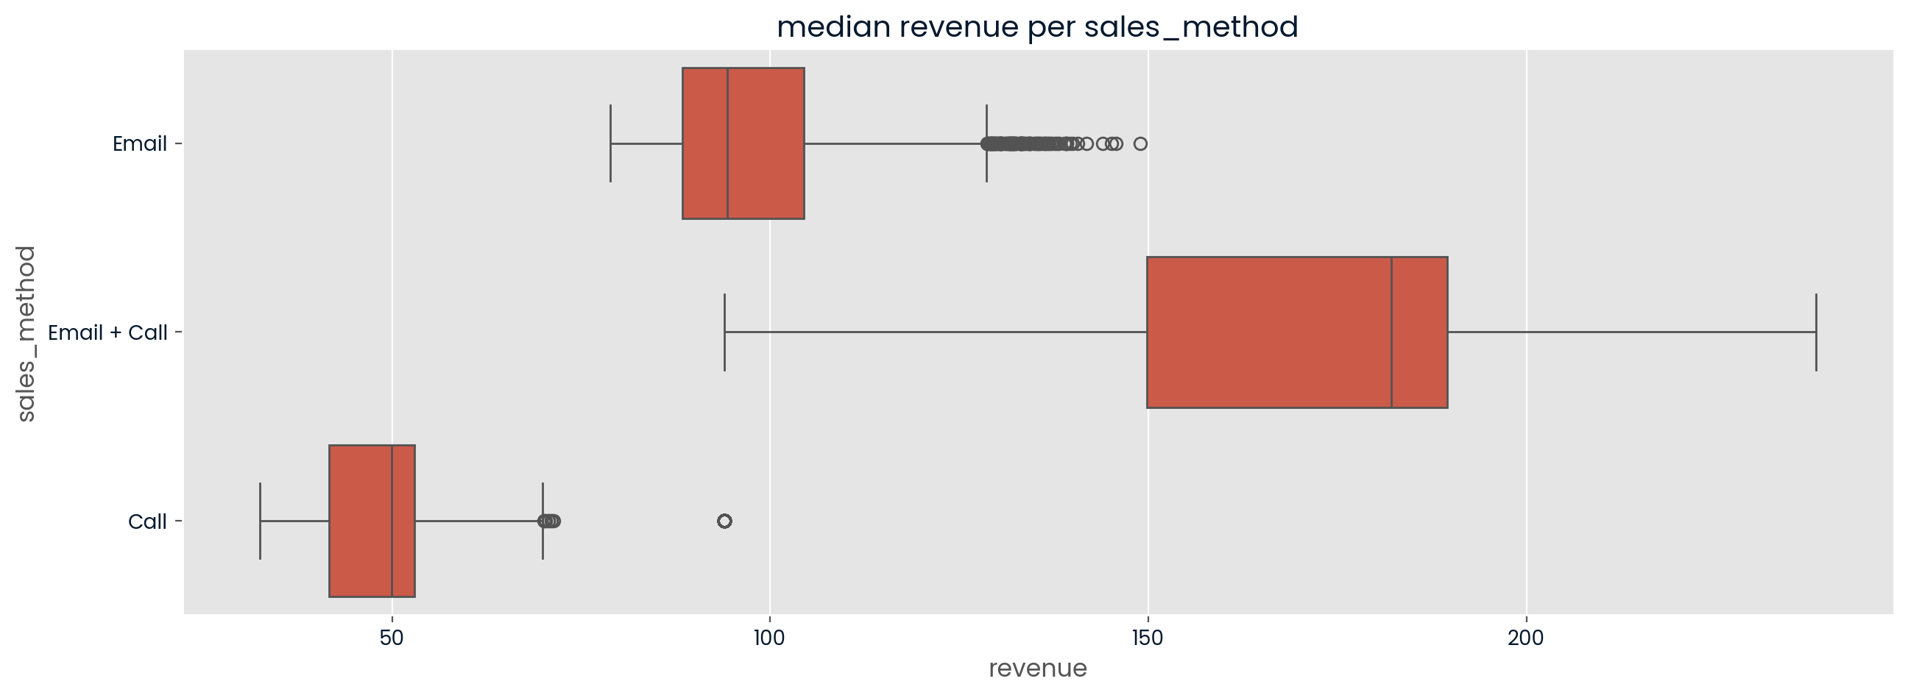
Exploratory Analysis - Question 2 Pt. 2
What does the spread of the revenue look like for each sales method?
● Calls were the least productive method displaying sales values ranging from~40-70 which is significantly lower than either of the other sales methods.
● The Email method produced medium sized revenue values, with most falling between $80-$120, and some outliers in the $130 $150 range.
● Lastly, and most importantly, the Email + Call method produced the strongest results. This method produced values with a minimum of 120 and ranging to 240

Slide 8

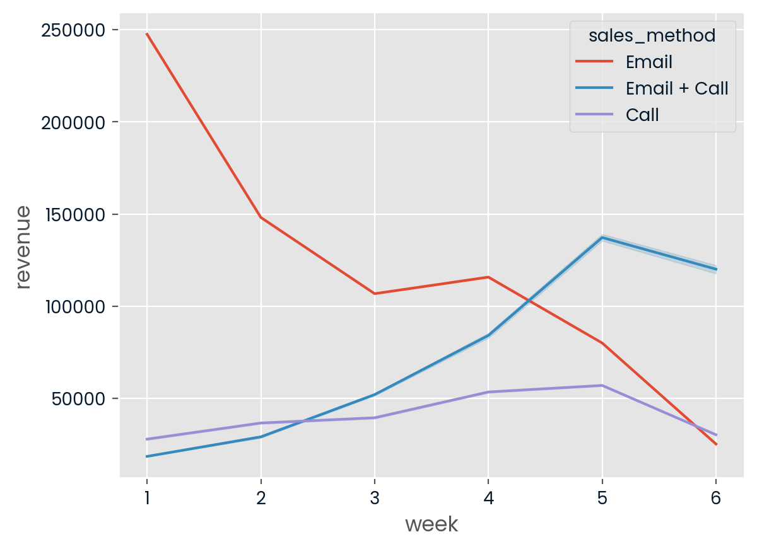
Exploratory Analysis - Question 3
Was there any difference in revenue over time for each of the methods?
● Revenue produced by the Email method started out significantly higher than the others (229765.55) but decreased by 58% in the following two weeks to 98792.14 and continued that trend for the most part. Despite the crumble here, it was still a better option than that of calling alone.
● The Email + Call method started out the lowest (16885.33) but it ended the period at the top spot(111152.07), rising on all weeks except the final.
● The Call only method produced mediocre results the entire time, starting at around 26159, and ending at 28252. Since this method is very time intensive but also is producing poor results, we should aim to do away with it.

Slide 9
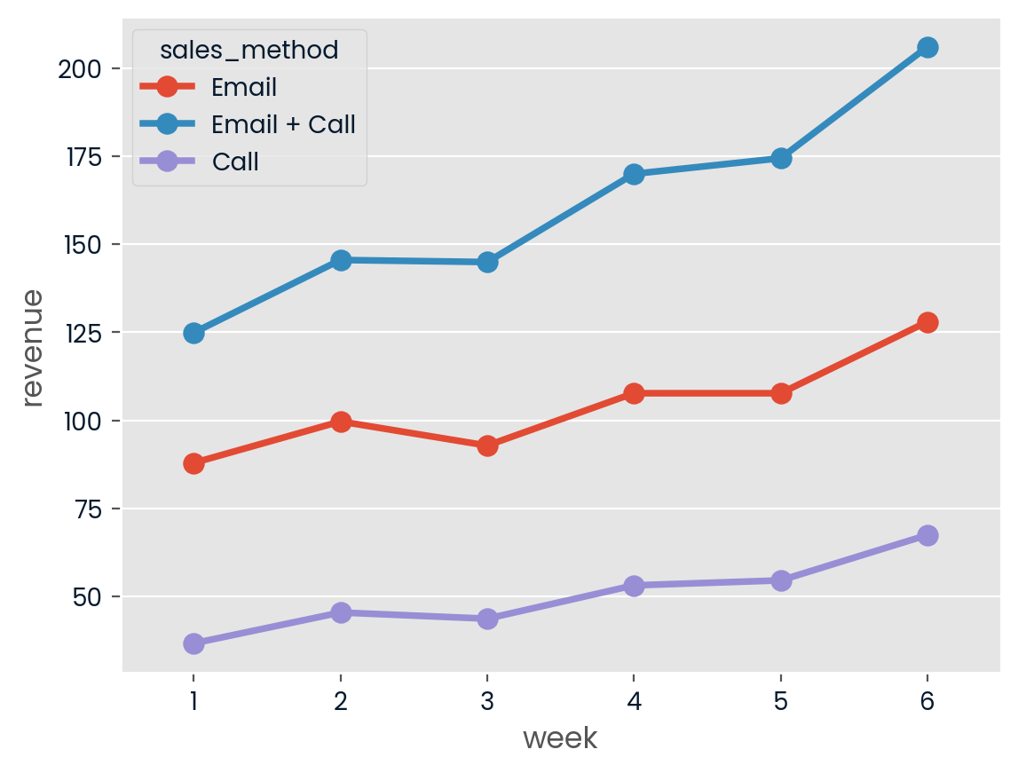
Recommendations
Based on the data, which method would you recommend we continue to use?
● Based on the included charts and graphs, it’s clear that the Email + Call method was the most successful in producing revenue. It trended upwards across the 6 week period while still being a relatively light lift for your team. I recommend that the team focuses here as the average sale came in at almost double that of any other method.
● Emailing also proved to be a success for the most part, requiring little time from your team while producing medium sized sales. The average sale by email was $97 during the 6 weeks. Consider leveraging targeted email campaigns as a supplement to the Email + Call approach.
● The calling method provided consistently poor results so I would suggest you try to pivot away from solely using this method or else you may be wasting time/resources. This method is pretty time intensive so I think it would be best to supplement with regular emailing in order to stay relevant with customer

Slide 10
Business Metric to Focus On
How should the business monitor what they want to achieve?
● Because the company is focused on increasing revenue and profits by selling more products, I would suggest they focus on the metric of average weekly revenue generated from each methodas their main performance indicator.
● I think average weekly revenue generated would be a good area of focus because it can be measured over time and analyzed to identify trends across a given time period. This would allow the team to decide if they should pivot to other strategies if they are not tracking well towards their goal.
● On average, Email+Call produced the highest average revenue across all weeks, and trended upwards for almost all 6 weeks.
● The estimates for initial values of this metric (Weekly Avg Revenue per Sales Method) with a focus on the recommended approach (Email + Call) are 128.89, 154.24, 150.42, 180.82, 187.58, and 227.77 for weeks 1-6 respectively.

Slide 11
Summary and Parting Thoughts
• To summarize, I feel that this company should use a multi channel approach to reach their sales goals. Email + Call showed a significantly higher return on time invested and this information could help the company optimize operations to increase performance and revenue generation.
• I also think a follow up call a day or two after the product information email could go a long way in converting sales. Given my experience in sales, waiting a week or so to make a call often leads to less pick ups or people not remembering the email.
• It's important to be persistent and aim to get timing on your side for these kinds of things. With the right efforts and focus on the proven approaches, the team can rise above the competition and break through the noise

Slide 12
THANK YOU
Shaker Fayez
shakerfayiz21@gmail.com

